Slide 1
An investigation of PPR protein binding in plant chloroplasts
Haydn King
Jesus College
hjk38
Supervisors:
Jorge Gonçalves (internal)
Jim Haseloff (external)
Reference: F-JMG77-type(b)

Slide 2
Synthetic Biology
Applying Engineering Principals to Biology
  Encapsulation, Standardisation, Characterisation, etc...
Synthetic Biology is not Genetic Engineering

Slide 3
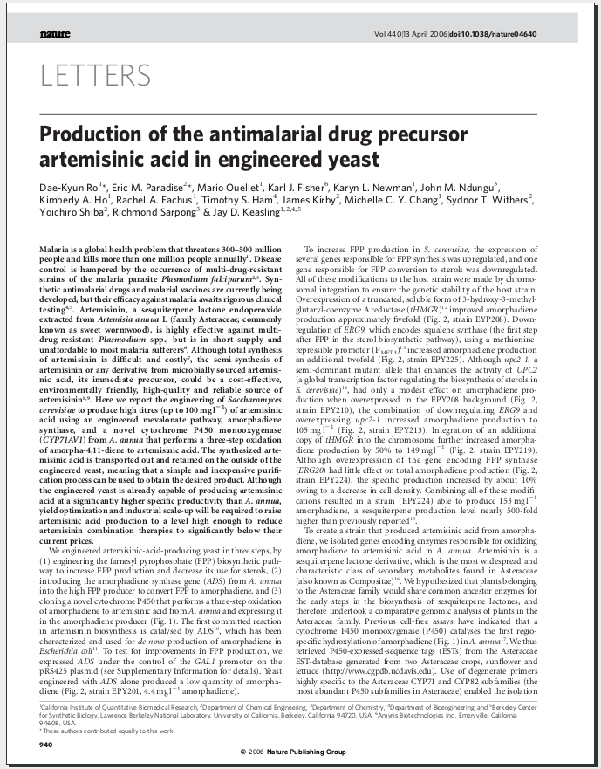
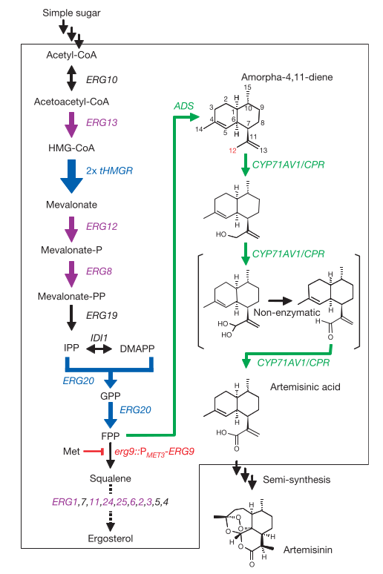

Slide 4
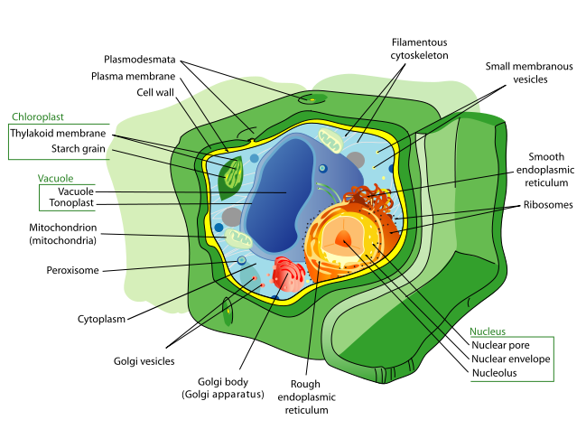
Chloroplasts
A cell within a cell
Where photosynthesis takes place
RuBisCo is the most abundant protein on earth
Image: Wikimedia commons

Slide 5
A 30 second introduction to information flow within the cell
DNA
Transcription
RNA
Translation
Protein
Long Term Storage
(521 year half life)
Short Term Message
(minutes to hours)
End Product
Control is usually achieved by up or down-regulating transcription or by modifying the mature protein

Slide 6
Advantages of the Chloroplast for Biosynthesis
Large amounts of energy present (photosynthesis)
Relatively simple (prokaryote-like)
More complicated plant machinery available
Very high copy number per cell
  10 to 100 chloroplasts, each with 10 to 1000 chromosomes

Slide 7
Chloroplasts - II
Most of the genome is under constitutive promotion
Control appears to be by Protein/mRNA binding
Nucleus indirectly controls chloroplast translation using chloroplast targeting proteins

Slide 8
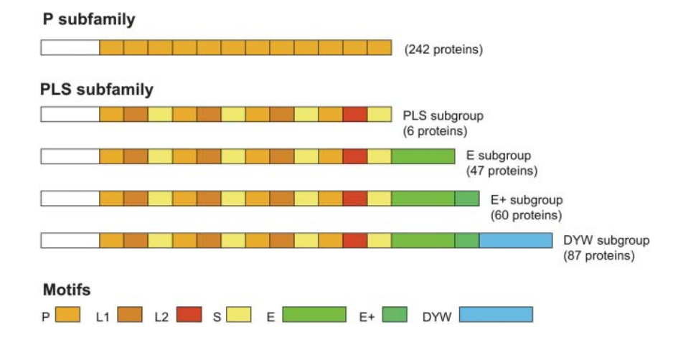
Pentatricopeptide Repeat (PPR) Proteins
A class of proteinaceous message sent from nucleus to chloroplast
Binds to a specific RNA sequence in the chloroplast (4 to ~25 bp long) determined by repeat regions
Genome-wide analysis of Arabidopsis pentatricopeptide repeat proteins reveals their essential role in organelle biogenesis.
Lurin et al., The Plant Cell, 2004

Slide 9
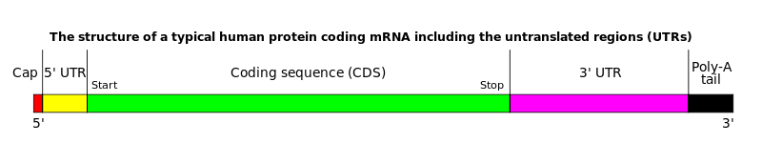
Influencing Protein Levels in the Chloroplasts
PPRs can bind to the 5' and 3' UTRs and increase lifespan of the mRNA
PPRs can bind to the Ribosome Binding Site (RBS), preventing translation

Slide 10
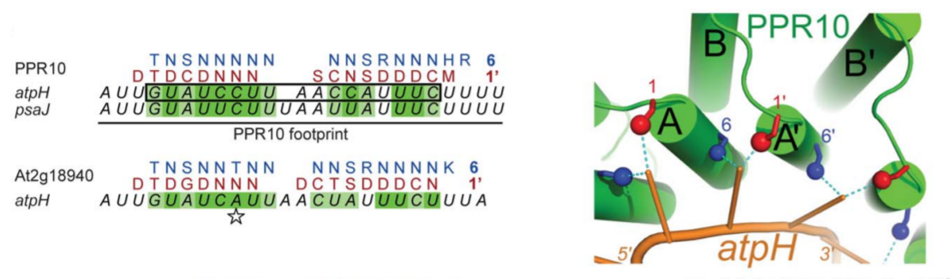
PPR Binding Rules
Recently published paper discovered a strong correlation between PPR domains and RNA target sequence
Mutated PPR protein changes binding preferences as predicted
A combinatorial amino Acid code for RNA recognition by pentatricopeptide repeat proteins.
A. Barkan, M. Rojas, S. Fujii, PLoS Genetics, 2012

Slide 11
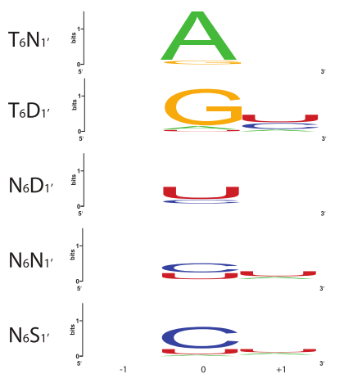
Example Target Logos

Slide 12
Goal 1: Automatic Construction of a Library of putative PPR/RNA Pairs
Discover PPR domains in 6-frame translations of the genome using Hidden Markov Model (HMM) search
Extract proteins from chains of sequential domains
Use the binding rules to create a HMM representing the target sequence
Find highly scoring matches in the chloroplast genome
Compare matches across plant species and find homologies

Slide 13
Progress
Wrapper for HMMER's “hmmsearch” tool written
  Can read and write HMM models
  On-the-fly 6-frame translations for searching for Protein models in DNA sequence
  Parses output and returns python objects
Can extract chains of PPR repeat regions and extend 3' and 5' ends to extract start-codon to stop-codon
Returns a BioPython SeqRecord annotated with features indicating the PPR domains
  Using Arabidopsis as a well annotated test, 108 annotated PPR proteins found in genome

Slide 14
Current Challenges
Many discovered proteins contain gaps in the repeat sequence
  Need to investigate whether these are unannotated PPR repeats or introns
Classify PPR by sub-family
Build HMM models of RNA target
  Hard work already done
Discover targets in chloroplast chromosome
  Difficult when searching for short sequences, high probability of false positives
  Look for context of discovered targets (coding, RBS, UTR etc)

Slide 15
Goal 2: Demonstration of PPR based expression control in E. Coli
Useful to discover whether PPR proteins can be used for control in other organisms
Attempt to control the expression of Green Fluorescent Protein (GFP) in E.Coli using an inducible PPR generator and well characterised PPR/RNA pairs
Wet-work planned for next term

Slide 16
Questions

Slide 17
Hidden Markov Models
A Markov Model where each state emits a symbol from an alphabet, with probability distribution defined by the state
The sequence of symbols is known, but not the sequence of states
Transition and Emission probabilities can be learnt with Expectation Maximisation
Network topology is a “dark art”

Slide 18
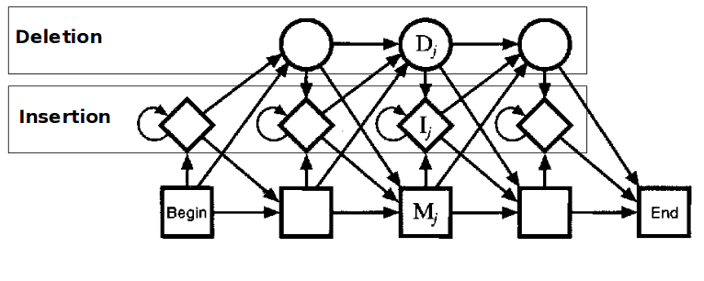
Profile HMMs
HMMs which have a set network topology

